Slide 1

Nokia WING
Habilitación de IoT más allá de fronteras y tecnologías
24/06/21
Notes:
Nokia’s Worldwide IoT Network Grid or WING is a one-stop IoT enablement service that Nokia offers to operators to serve their enterprise clients at a global scale.
WING is a service, but combines a global IoT infrastructure as a service and real-time connectivity management platform with a fully managed service. This combination makes WING unique in the market.
WING is built upon a carrier grade and market proven portfolio of Nokia network, software and services.
It is fully hosted by Nokia in public data centers across different parts of the globe and is fully managed by Nokia Managed Services

Slide 2








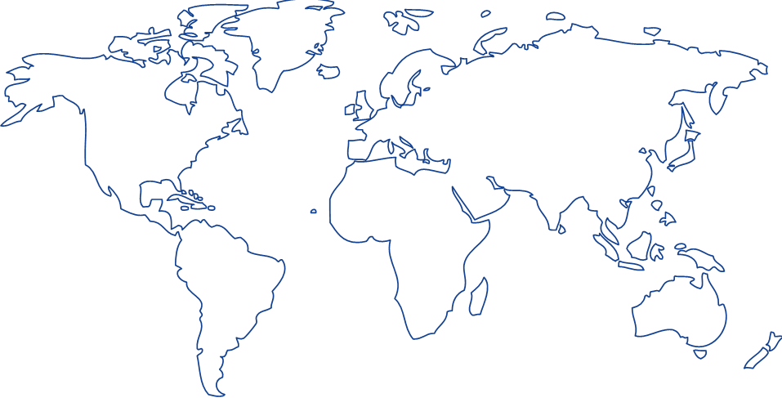
Internet de las Cosas es la revolución tecnológica de nuestro tiempo
Equipamiento “inteligente” con capacidades de red
3
2
Dispositivos “inteligentes” con conectividad integrada
Objetos físicos “estáticos”
1
1
Personas
Lugares
Internet fijo con 1000 millones de lugares conectados en 2005
Internet móvil con 5 mil millones de personas conectadas en 2021
74 mil millones de cosas conectadas para 2025
Source: Statista

Slide 3




Desafíos de las empresas
Acortar plazos de comercialización y acelerar crecimiento de ingresos
Control de Costes
¿Cuál es la mejor manera de optimizar mis procesos, reducir mis costes y evitar altos precios de roaming, especialmente en casos de elevado uso de datos?
Conectividad fiable con alcance global
¿Quién puede ser un socio que nos proporcione conectividad global con baja latencia en todas las regiones, sin comprometer la calidad y cumpliendo la regulación local?
Innovación en productos y experiencia de cliente
¿Quién puede ser un socio estratégico en IoT para ayudarnos a entrar en nuevos mercados, desarrollar productos innovadores e introducir nuevas tecnologías?
¿Cómo incrementar mis dispositivos conectados de forma eficiente para generar nuevas fuentes de ingresos?

Slide 4



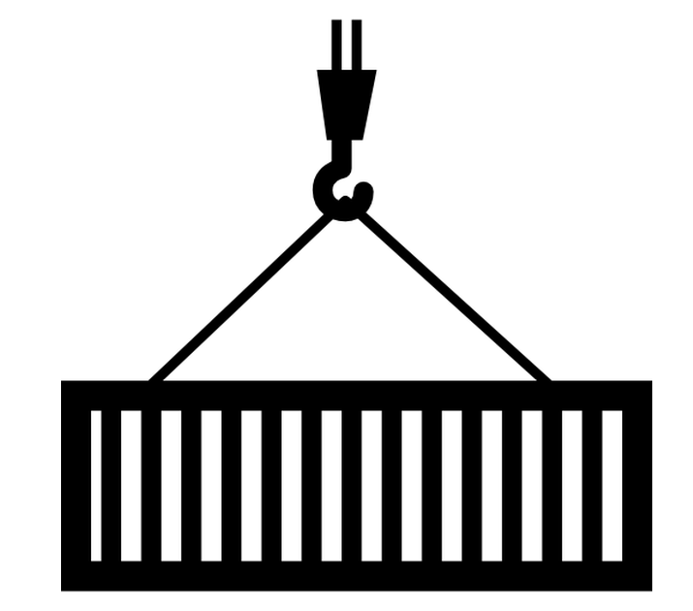








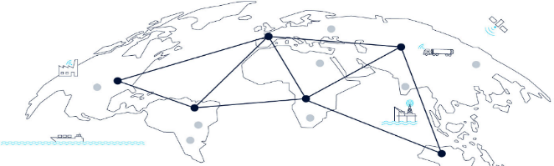
Nokia Worldwide IoT Network Grid (WING)
Soporte Alianzas
Servicios Gestionados
Soporte
GTM
Agricultura
Ganadería
Logistica
Gestión Activos
Automóvil conectado
Servicios Verticales
Ecosistema Global Partners
IoT Command
Center
WING
Plataforma
IoT
Gestión Dispositivos & Aplicaciones
Soluciones
SIM
Securidad & Analytics
WING Digital Hub
Plataforma Gestión Conectividad
WING
Core Global
IoT aaS
Notes:
This slide gives the big picture view of WING, and many of the different parts will be explained further in the coming slides.
Key points to mention here:
The heart of WING is the Global IoT Core infrastructure which is offered as a service to operators
On top of the infrastructure, we layer a single global Connectivity Management Platform and also key capabilities like device & application management, security & analytics, etc.
We support intelligent SIM solutions for multi-IMSI switching, and the ability for MNOs to act as a bootstrap provider for devices that ultimately register on other networks
WING includes a 24x7x365 IoT command center to help resolve any network issues quickly
WING Market Entry Services can consult with operators on best approach to IoT, taking into account their unique situation and needs.
Best of all, the investment that Nokia is making into this infrastructure is offered to the operator in a flexible as-a-service model, enabling a range of pay-as-you-go, revenue-sharing, or licensed-based business models. Operators no longer must invest a large sum of capex to get into the IoT business globally, but can instead get into the market with a more reasonable opex investment. This means operators can launch multiple new IoT services more quickly and then quickly scale globally the services that take off and kill the ones that don’t – all without stranding any capital investment. This flexible, as-a-service business model can be attractive to operators even for IoT services within their own service area.

Slide 5





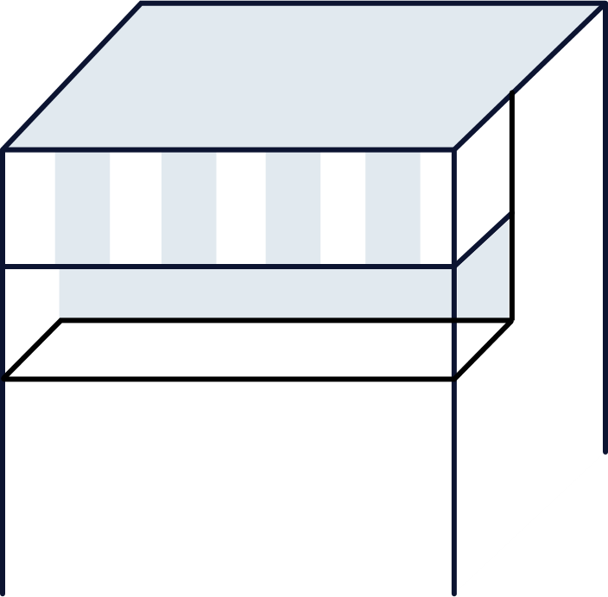
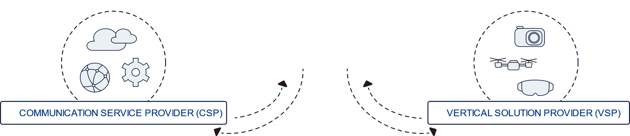







Nokia IoT: Worldwide IoT Network Grid (WING) + IMPACT
EMPRESAS
  Lanzamiento rápido de nuevos servicios IoT
  Gestión simplificada a nivel global
Eficiencia de las soluciones IoT
  Control de costes de conectividad
  Fácil integración en sistemas empresariales
  Gestión dispositivos y mejora de calidad del servicio
Cobro en tiempo real y control de fraude de IoT
Gestión de pedidos y provisión
Servicio proporcionado con la marca del operador o proveedor de soluciones verticales
NOKIA WING + IMPACT
Solución E2E totalmente virtualizada
Mejora la gestión de la conectividad del M(V)NO y la Empresa
Multi-país, multi-tecnología
Plataforma IoT
Servicio Gestionado IoT
Gestión de dispositivos/sensores y recogida de datos
Automatización y análisis de negocio
IoT aaS –Modelos de negocio flexibles
3-4x Ingresos
Alcance
4-6x tiempo de amortización
Riesgo
Alcance
Esfuerzo de integración
Riesgo
IoT Core
OPERADOR DE COMUNICACIONES (CSP)
PROVEEDOR SOLUCIONES VERTICALES (VSP)

Slide 6


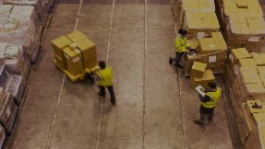

Nokia WING Soluciones Verticales
Soluciones extremo a extremo para generar nuevos ingresos IoT
Agricultura inteligente as a Service
Acceso asequible por suscripción a datos regionales sobre el clima, el suelo y las plagas para reducir los costos y mitigar los riesgos
Gestión Ganado as a Service
Ubicación inteligente del ganado y gestión sanitaria durante la gestación o en caso de enfermedad o lesión
Soluciones extremo a extremo
para verticales específicos, incluyendo sensores / dispositivos, aplicaciones y modelos de suscripción
Best-in-class partners
Con dispositivos y aplicaciones pre-integradas
Gestión de activos as a Service
Simplificar la conectividad y la gestión para una variedad de bienes conectados, tanto industriales como de consumo
Gestión de flotas as a Service
Visibilidad de flotas para gestionar y maximizar el uso del vehículo, optimizar el mantenimiento y reducir los costos al tiempo que se garantiza la seguridad.
Único punto contacto
Para venta, operación y mantenimiento
Hardware / sensores
Software y apps móviles
Integración de Sistemas
Soporte
Operación & Mantenimiento
Soporte a Ventas
Notes:
As stated earlier, the WING vertical solutions cover the agriculture, livestock management, logistics and asset management markets.
Some of them are not the usual suspects for operators (e.g. agriculture or livestock management), while other are more mature ones (such as logistics or asset mgmt), requiring global connectivity. According to Machina Research, the agriculture sector is forecasted to be one of the fast growing IoT sectors, with 22% annual revenue growth through 2024. With this in mind, customer interest led us to develop the Smart Agriculture as-a-Service, recognizing the need on the part of operators to offer a differentiated IoT agriculture solution in thier markets. From there, there is a natural progression to the livestock management space, as farmers often raise both crops and livestock.
In the logistics markets, IoT devices require real-time connectivity across borders and networks so that global logistics and supply companies can know exactly where goods are at any given time as shipments move across borders and different transportation modes such as railway, trucking, and maritime. This is a natural fit for the capabilities that WING brings to the operator.
Related to logistics but also unique is the challenge of connecting the connected good – both consumer products such as the smart refrigerator that keeps track of stocking levels and industrial such as large power transformers that need to be monitored remotely for many years – that can benefit from simplified connectivity. The manufacturers ship these products all over the world and don’t want to be burdened with getting the connectivity to work. Instead, they want solutions like WING that enable them to ship anywhere in the world and connectivity is as easy as turning on the power.
1. The first one is ‚Smart agriculture aaS’ which reflects to our CSP customer needs to find new revenue sources and make a difference in developing countries. Sensors capture environmental, soil and crop data that is then analyzed to provide insights that help farmers manage crops more effectively, potentially saving costs on irrigation, pesticides and fertilizers.
(Agri – start here b/c smb focus, opportunity in dev mkts to make a difference)
Increase yields by an average of 7%
Reduce seed and fertilizer by an average of 8%
Reduce fuel costs by an average of 6%
2. Livestock Management aaS. Here tracking devices and biosensors monitor animal health and welfare to provide ranchers with early alerts if abnormalities are detected, protecting valuable livestock and improving yields.
3. Logistics aaS. Logistics is one of the verticals – besides asset management - with a huge potential based on the various market studies. IoT sensors enable tracking of the global movement and condition of goods through the complete supply chain to help enterprises instantly identify incidents and even predict future events to optimize delivery and logistics process efficiency.
4. And finally Asset Mgmt aaS. It’s about connecting products anywhere in the world, enabling their status and performance to be monitored centrally, helping enterprises provide a better service to their business and consumer customers.

Slide 7
  Angel David Garcia Barrio
  Head of WING Product Line
  angel.garcia_barrio@nokia.com

